Slide 1
Friend Finder Django WebApp
Team: Filles Folles
Size: 3 people

Slide 2
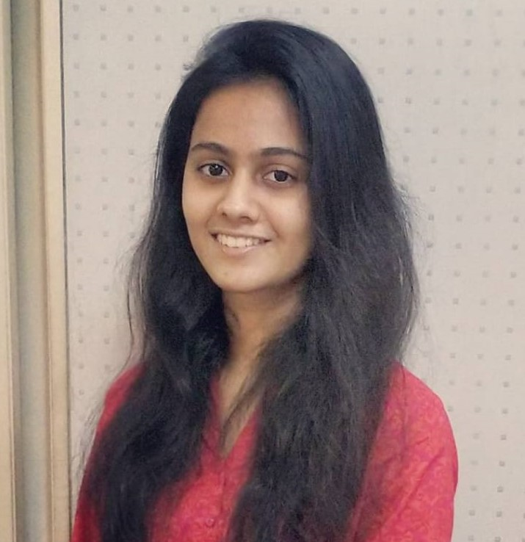
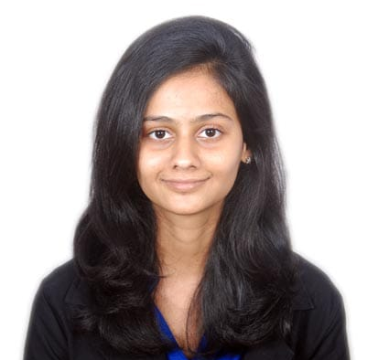
Team Members
Vidhi Mody
Role: User Registration,
Database Integration and Management.
Expertise: Web/ Mobile App development.
Darshee Machhar
Role: Personality Analysis on tweets using the IBM, tweepy APIs.
Expertise: Software Development, Cyber Security
Vrushti Mody
Role: Gamification of the Big Five Personality
Expertise: Mobile App Development, UI/UX

Slide 3
Technologies
Platform
APIs used.
Django Framework
IBM Watson API
Twitter API- Tweepy
TextBlob

Slide 4
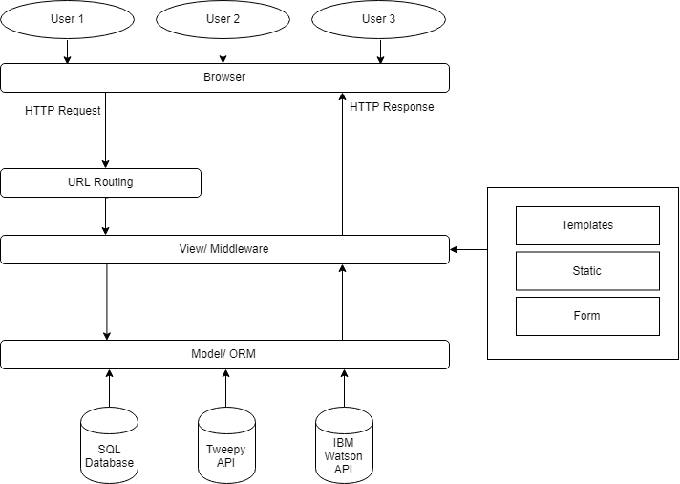
Architecture Diagram

Slide 5
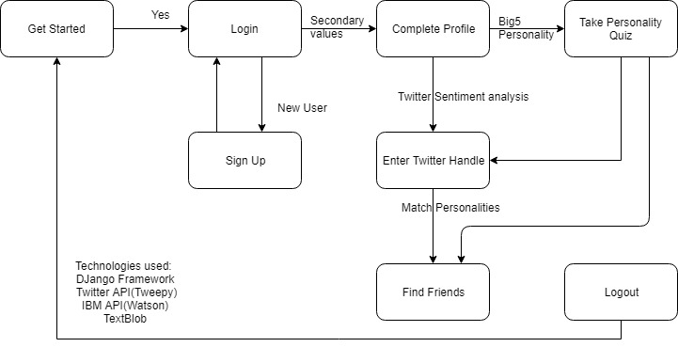
DTD / Flowchart

Slide 6
Frameworks/ Tools for UI/UX
HTML/CSS
HTML is used to create web pages for our web app. CSS is used to make the web pages more lively and interactable.
Bootstrap
Bootstrap is used for creating the layout of most of the web pages. Various other features like buttons, containers, etc have been used

Slide 7
THANK YOU.

